Slide 1
Math Tools
By Florian and Oleksandr
Group 1

Slide 2
Development Cycle
Planning
Designing
Implementing & testing
Polishing

Slide 3
Design Phase
Multiple mock-ups
Feedback
Combine results

Slide 4
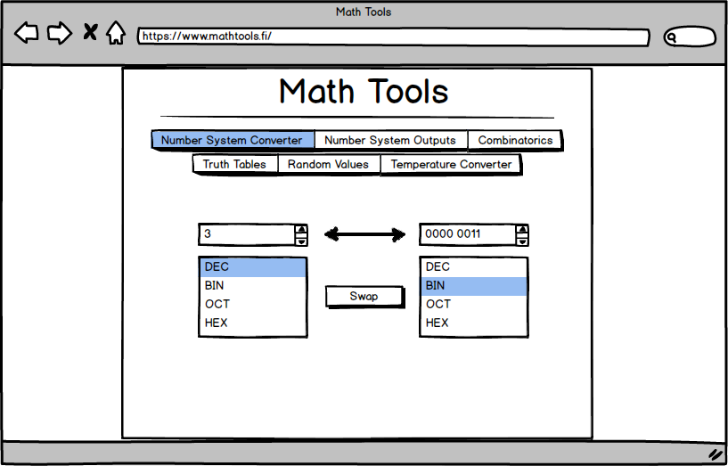
Number System Converter

Slide 5
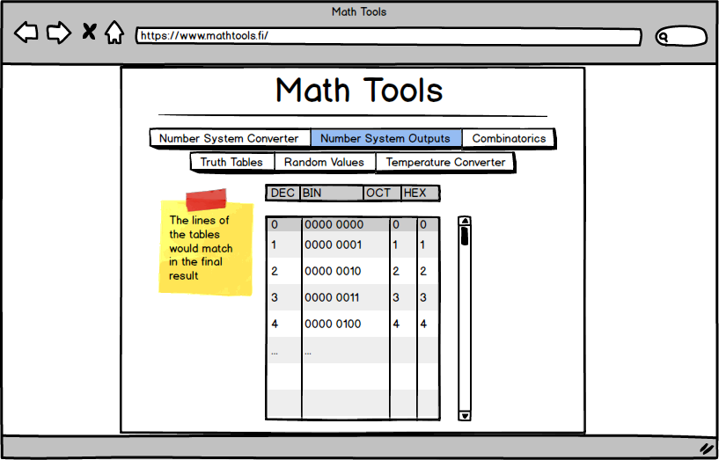
Number System Outputs

Slide 6
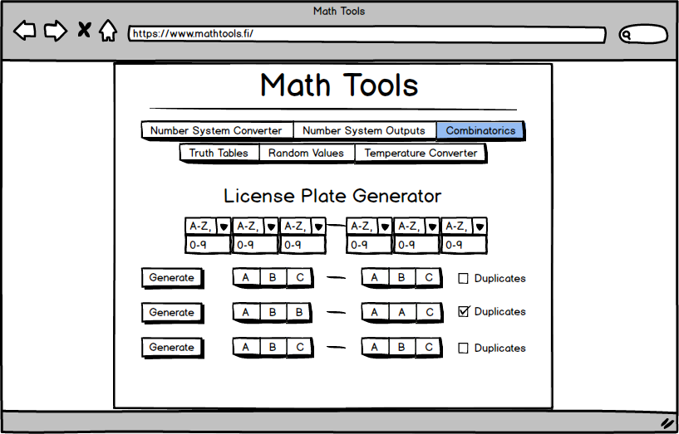
Combinatorics

Slide 7
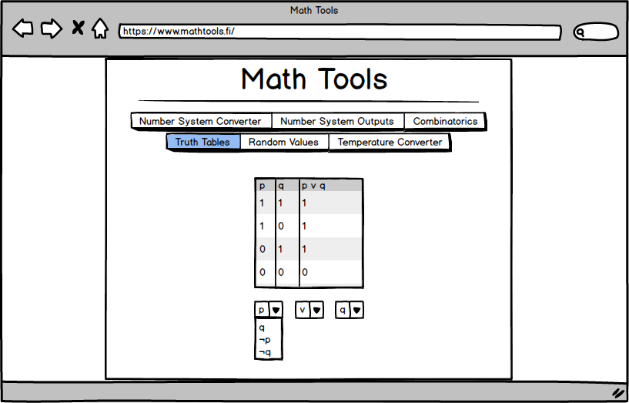
Truth Tables

Slide 8
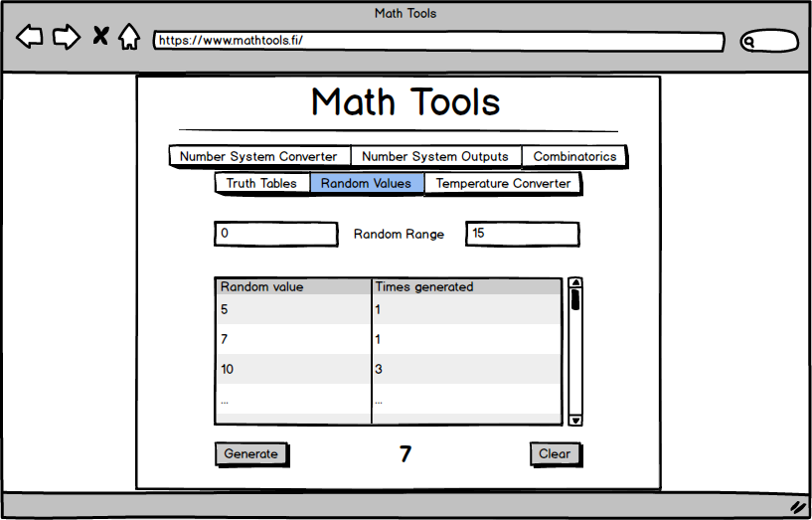
Random Values

Slide 9
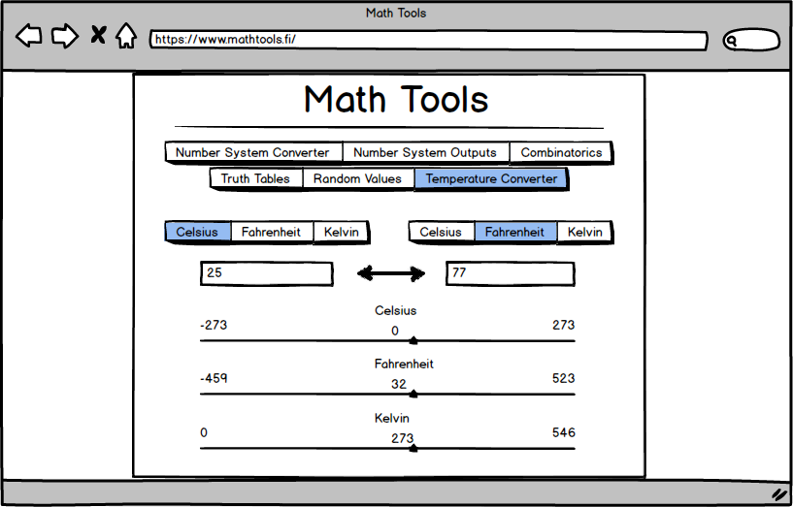
Temperature Converter

Slide 10
Implementation

